Slide 1
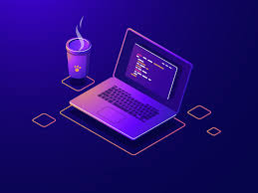
Programming
Dr B T Sampath Kumar
Professor
Department of Library and Information Science
Tumkur University, Tumakuru, INDIA
www.sampathkumar.info

Slide 2
Programing
Program is a set of instructions.
Programming is a process of creating a set of instructions that tell a computer how to perform a task.
Programming can be done using a variety of computer languages, such as C, C++, Java, HTML etc.
Collection of program is software.

Slide 3
Steps in programming
Understanding the problem.
Design a solution.
Write algorithm and draw flowchart.
Coding.
Programming testing and debugging.
Documentation.

Slide 4
Understanding the problem
This is the first step in programming.
The programmer should understand the problem thoroughly in terms of requirements i.e. what is the:
input and
output operations to be performed.
If the problem is not properly interpreted then it is not possible to obtain the desired results.

Slide 5
Design a solution
Once the problem is thoroughly understood, then it is necessary to plan for the method of solution.
Depending upon the size of the task, the program preparation may be shared amongst many programmers.

Slide 6
Cont..
Large programs may require each programmer to write a separate part of the program.
These separate parts are often called as modules or segments.
These modules may be prepared and tested separately, then linked together and tested as a whole program.

Slide 7
Write Algorithm and draw Flowchart
An algorithm is non-computer language.
It is a problem solving technique.
It can be defined as a “step by step procedure to solve a particular problem”.

Slide 8
Algorithm to add two numbers
Step 1: Read two numbers a, b
Step 2: Add two numbers (c=a+b)
Step 3: Print the sum, c
Step 4: End of algorithm
Step 5: Stop

Slide 9
Algorithm to calculate the area of a triangle
Length (l)
Step 1: Start
Step 2: Read length and breadth
Step 3: a=1/2*b*l
Step 4: Print ‘a’
Step 5: Stop
Breadth (b)

Slide 10
Flowcharting
Flowcharting is a method of representing with symbols, their operation and their sequence of execution in information processing.

Slide 11
Symbols used in Flowchart
Start/Stop
Decision
Input/output
Connector
General processing

Slide 12
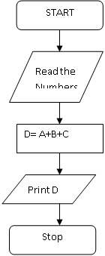
Flowchart to add three numbers
Read the numbers

Slide 13
Coding
The process of writing computer instructions in a programming language (C or C++) is known as Coding.
Program written in C is as follows:
int main()
{
int a,b,c,d;
printf(“Enter any three numbers");
scanf("%d%d%d", &a, &b, &c);
d=(a+b+c);
printf("The sum of three number is = %d\n",d);
}

Slide 14
Program testing and debugging
The programmer might have made logical errors in sequencing or perhaps errors were made in entering the code.
The process of correcting such errors is called debugging.

Slide 15
Documentation
For a programmer reliable documentation is always a must.
The presence of documentation helps keep track of all aspects of an application and it improves on the quality of a software product.
Its main focuses are development, maintenance and knowledge transfer to other developers.

